Slide 1


Slide 2
Verily Firaun exalted himself in
the land and made its people
in sects, weakening a party
among them, slaying their sons
and letting their girls live.
Verily he was of the corrupters
28:4
Notes:
Leader should not exalt himself, should not divide people into sects, should not weaken one group, should not deprive them of their rights and should not do corruption.
There are number of explanations of transformational leadership. My concept is reverse of style mentioned in ayat.
Transformational leadership is concerned with emotions, values, ethics, standards, and long-term goals. Lets judge my concept on this standard.

Slide 3
Leadership
Chapter 9 –
Transformational Leadership
Northouse, 4th edition

Slide 4
Overview
Transformational Leadership (TL) Perspective
A Model of Transformational Leadership
Transformational Leadership Factors
Full Range of Leadership Model
The Additive Effects of TL
Other Transformational Leadership Perspectives
How Does the Transformational Approach Work?

Slide 5
INTRODUCTION
Latest approach
Charisma and affective elements
1/3 research
Other fields
Intrinsic motivation and followers development
Notes:
Latest and current apch. Since 1980s
Gives more attention to charisma and affective elms of leadership
A research found in 2001 that 1/3 research was on tsfl and charism leadership.
The research not limited to traditional fd like mgmt. but extended to nursing, medical, education fds also
Popularity is probably because of its emphasis on intrinsic motivation and followers dev, which fits todays work groups.

Slide 6
Transformational Leadership
Description
Process - TL is a process that:
  changes and transforms individuals
  frequently incorporates charismatic and visionary leadership
Influence - TL involves an exceptional form of influence that moves followers to accomplish more than what is usually expected of them
Notes:
A cadet is different person and an officer is different person
Influence not status quo
Charismatic is a person who possesses special traits that attract, inspire, or fascinate other people

Slide 7
Transformational Leadership
Description
Core elements - TL
  is concerned with emotions, values, ethics, standards, and long-term goals
  includes assessing followers’ motives, satisfying their needs, and treating them as full human beings
Encompassing approach – TL
  describes a wide range of leadership influence
    Specific: one-to-one with followers
    Broad: whole organizations or entire cultures
  follower(s) and leader are inextricably bound together in the transformation process
Notes:
Encompassing means wholesome

Slide 8
Types of Leadership Defined by James McGregor Burns (1978)
Transformational Leadership
  Emphasized the difference between sources of authority
    Two types of leadership
      Transactional – contractual management
      Transformational (transforming) – “occurs when one or more persons engage with one another in such a way that leaders and followers raise one another to higher levels of motivation and morality” (1978)
      Pseudotransformational – personalized leadership rather than others
Notes:
Txl- Focuses on exchanges. bulk of leadership models. Eg politician who promises no new taxes, or manager who promises promotion to those who surpass others, Teacher giving grades if students study
Tsfl ldr is attentive to followers needs and motives and tries to help followers to reach their goals. Eg Rayon White an aid worker who raised people awareness. A manager who attempts to change company’s corporate values to reflect a more humane std of fairness and justice. In the process both leader and followers emerge with a stronger and higher set of values. WHAT ABOUT HITLER AND SADDAM? They were transforming people, isn’t it? Yes but in negative way. For this the term used is Pseudotransformational, which means leaders who are self-consumed , exploitative and power oriented with wrapped values.

Slide 9
Types of Leadership Defined
Burns (1978)
Focuses on the
exchanges
that occur
between leaders
and their followers
No new taxes = votes.
Sell more cars = bonus.
Turn in assignments = grade.
Surpass goals = promotion.
…
The exchange dimension is so common that you can observe it at all walks of life.
TRANSACTIONAL

Slide 10
Types of Leadership Defined
Burns (1978)
Leader is attentive to the needs and motives of followers and tries to help followers reach their fullest potential.
Process of
engaging with others
to create a connection
that increases
motivation
and morality in both the
leader and the follower
Quaid & Mohandas Gandhi – raised the hopes and demands of millions of their people and in the process were changed themselves
TRANSFORMATIONAL

Slide 11
Types of Leadership Defined
Burns (1978)
Process of
engaging with others
to create a connection
that increases
motivation
and morality in both the
leader and the follower
Organizational example - A manager attempts to change his/her company’s corporate values to reflect a more humane standard of fairness & justice – In the process both manager & followers may emerge with a stronger & higher set of moral values
TRANSFORMATIONAL

Slide 12
Types of Leadership Defined
Burns (1978)
Leaders who are
  transforming but in a negative way
  self-consumed, exploitive, power-oriented, with warped moral values
includes leaders like
  Adolph Hitler
  Saddam Hussein
Focuses on the
leader’s
own interests rather than the interests of their followers
PSEUDOTRANSFORMATIONAL

Slide 13

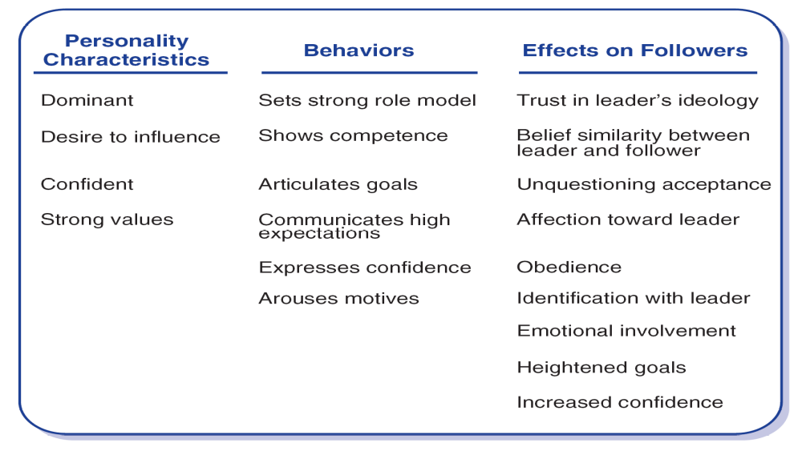
Theory of Charismatic Leadership (House, 1976)

Slide 14
ANY QUESTION?

